Slide 1
Requirements Engineering – a Process viewpoint
Presentation at Lero Industry Event, April 2011
Dr. Ita Richardson, Lero@UL

Slide 2
Software Process
“Set of activities, methods, practices and transformations that people use to develop and maintain software and the associated products”
Paulk et al., 1993

Slide 3
How well does the software work?
Functional Requirements
Non-Functional Requirements
“Good-enough
Software”
SW development productivity / predictability
SW process capability & maturity

Slide 4
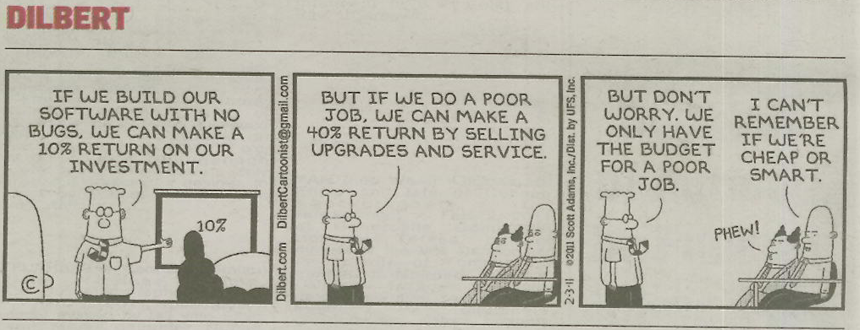

Slide 5
Software Process: Requirements
Capability Maturity Model Integrated
  Requirements Management
  Requirements Development
ISO 15504 (formerly SPICE)
  Requirements Elicitation (CUS)
  System Requirements Analysis & Design (ENG)
  Software Requirements Analysis Process (ENG)

Slide 6
CMMI - Version 1.3
Requirements Development (RD) elicits, analyses, and establishes customer, product, and product component requirements.
Requirements Management (REQM) manages requirements of the project’s products and product components and ensures alignment between those requirements and the project’s plans and work products.
        Software Engineering Institute, 2010

Slide 7
RD and REQM
…….. For specific industries
  Regulated Environment
    Health, Financial Services, Automotive etc
…….. In specific environments
  Global Software Development, Services Development, Small to Medium Sized companies etc.

Slide 8
Specific Industry Example:
Health Information Systems
Do the Regulatory/Certification bodies need to review/approve your product?
  Medical Devices
  e-Health – Health Information Systems
  Automotive Systems
  Financial Information Systems

Slide 9
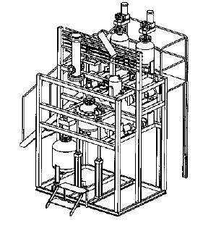
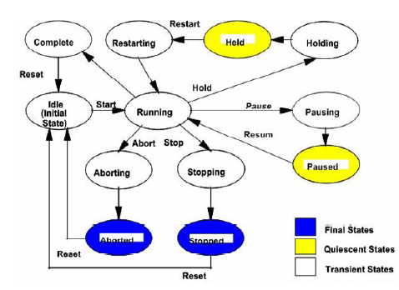
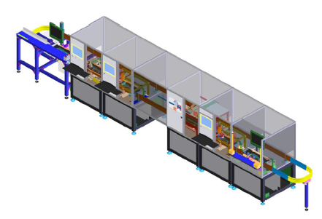

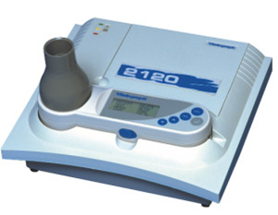
Healthcare software
Medical Device Software
  Up to 70% of budget on software related activities
Clinical data (Health Information Systems)
Software in Medical Device production lines

Slide 10
Importance for Consumers
Patients want data to be private, secure, accurate
Patients want correct treatments from
  Devices
  Clinical decisions
…WHICH ARE INCREASINGLY BASED ON SOFTWARE
Patients want treatments to be diagnosed effectively
  Devices
  Clinical decisions
…WHICH ARE INCREASINGLY BASED ON SOFTWARE
This is why we need regulation!

Slide 11
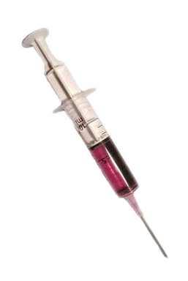
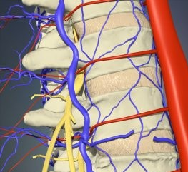

Slide 12
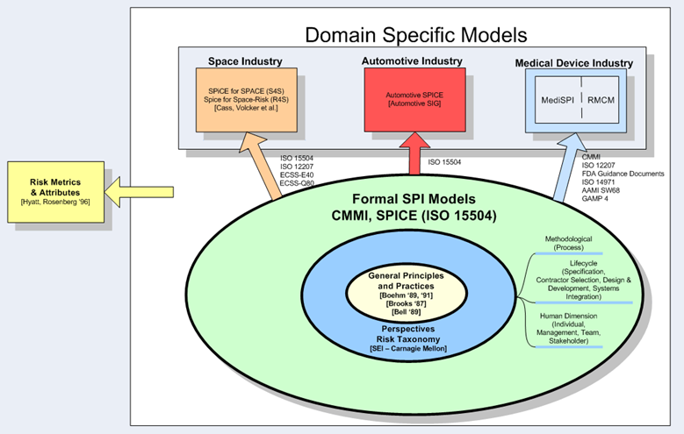
Software Development
General Process Models
CMMI
ISO15504
Various lifecycles
Medical Device Industry
ISO 12207
ISO 14971
AMMI SW68
GAMP4
FDA Guidance Documents

Slide 13
Effect on Software Industry
Standards not developed specifically for software development
Companies must be aware of regulatory requirements
Companies must be able to adapt software process to support regulatory requirements
Software process models have not been developed based on regulatory requirements
  Capability Maturity Model Integrated
  ISO15504

Slide 14
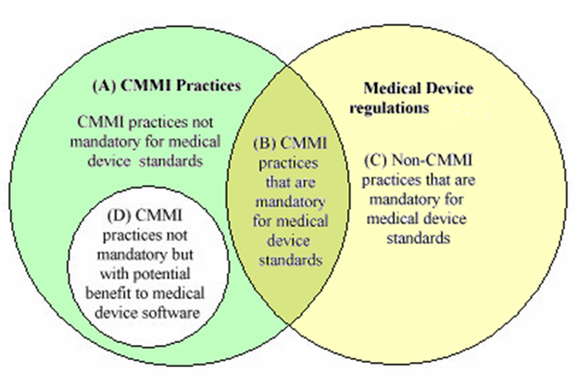
Capability Maturity
Model – Medical Device Software

Slide 15
Regulations
Code of Federal Regulations – Title 21 Section 820 (21CFR820 2009)
  Food & Drug Administration (FDA) Regulation
Sec 820.181 – Device Master Record
  Equivalent to Requirements Specification
Sec 820.184 Device History Record
Class I software - traceability and identification

Slide 16
RD: SG1 Develop Customer Requirements
No. | Deliverable | Legislation
SP 1.1 | Documented methods for need elicitation | 21CFR820 – Section 181/184 – Device Master Record(DMR) /Device History Record(DHR) – Production process specifications
SP 1.2 | Customer Requirements | DMR
SP 1.2 | Customer constraints on the conduct of verification | DMR
SP 1.2 | Customer constraints on the conduct of validation | DMR
        Shroff et al., 2011

Slide 17
RD: SG1 Checklist
SP 1.1 | Are stakeholder needs being recorded?
SP 1.1 | Have business goals being documented?
SP 1.1 | Have any relevant legal requirements been elicited?
SP 1.2 | Is there any missing information which at the end of the requirements consolidation which needs to be addressed? There should be none.
SP 1.2 | Are all conflicts resolved, and the decisions and reasoning documented?

Slide 18
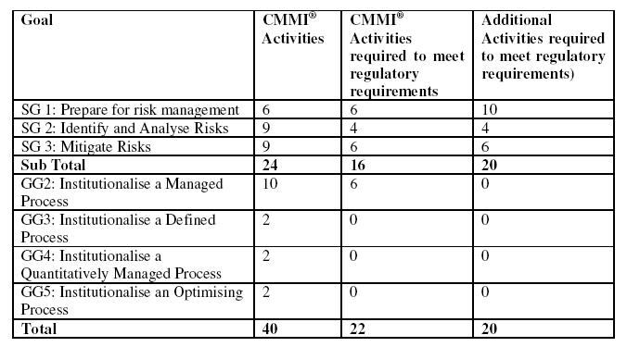
Risk Management
        McCaffery et al., 2010

Slide 19
Specific Industry Example:
Health Information Systems
Do the Regulatory/Certification bodies need to review/approve your product?
  Medical Devices
  e-Health – Health Information Systems
  Automotive Systems
  Financial Information Systems

Slide 20
Specific Environment Example:
Global Software Development
How can you ensure that the processes you implement will work in a Global environment?
Local processes are not global processes!

Slide 21
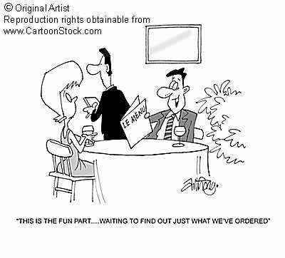

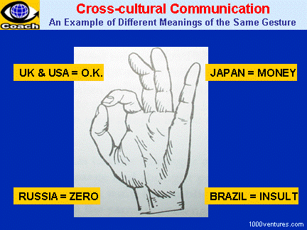



What happens in
Global Software Development?
Geographic Distance
Linguistic Distance
Cultural Distance
Temporal Distance
Notes:
Culture
When we in Ireland and UK speak to colleagues from across the pond in the US, we sometimes have misunderstandings even though we all speak English. Even though they understand every word I say, they don't understand anything that I have said. Consider that specification alone does not make an IT project successful. Are you of the belief that if someone understands the problem from a consumer perspective that they may be able to deliver better results? For example, imagine the business need to sell Rum over the Internet where having the right experience for the consumer is vital. Could you predict that even with bad requirements, the odds are improved by having someone in Trinidad or Jamaica develop it over someone in say Saudi Arabia? Use appropriate people with domain knowledge, think about that above labour costs?

Slide 22

Geographic Distance +
Linguistic Distance +
Cultural Distance +
Temporal Distance
=
Global Distance

Slide 23
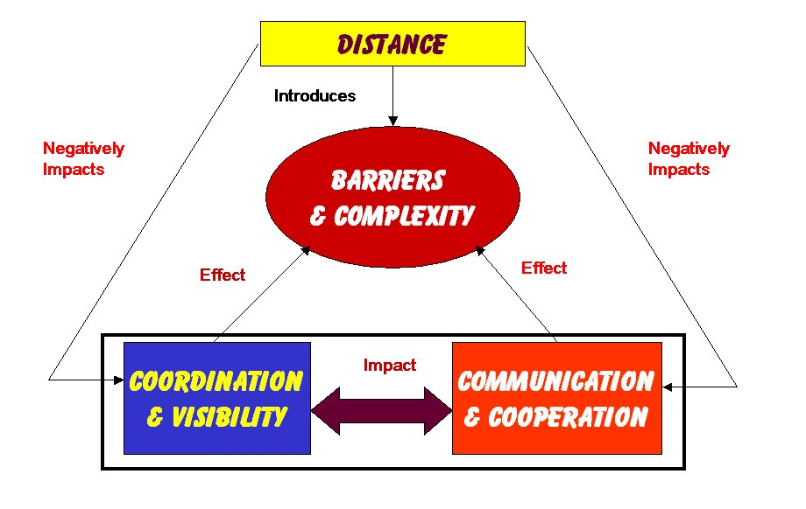
Implementing Global Software Development
Casey, 2008

Slide 24
Examples:
Defined Roles and Responsibilities
Skills Management
Effective Partitioning
Technical Support
Reporting requirement
Process Management
Team Selection
Motivation
Fear and Trust
Communication Issues
Cultural Differences
……….
Many of which are not software development / engineering / process factors
What are the BARRIERS AND COMPLEXITIES?
There are many factors at play in Global Software Development –

Slide 25
What are the BARRIERS AND COMPLEXITIES?
There is no one model for Global Software Development

Slide 26



















Variety of Collaboration Models
(Šmite, 2007)
19 MODELS
OUT OF
38 SURVEYED
PROJECTS

Slide 27
Collaboration Models

Slide 28
Global Teaming Model
Process for effective Global Software Engineering
Global Teaming Model based on the structure of Capability Maturity Model Integrated
Can and should be used with existing processes

Slide 29
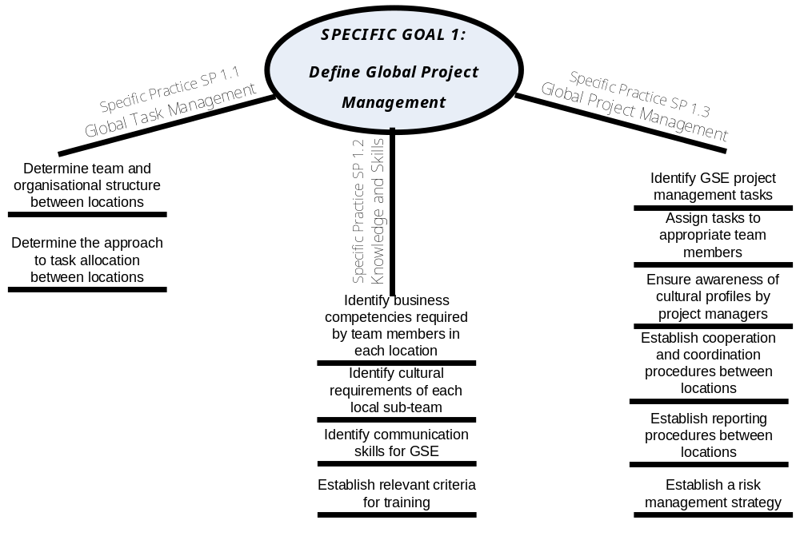
Global Teaming Model
Establish cooperation and coordination procedures between locations
        Richardson et al., 2010

Slide 30
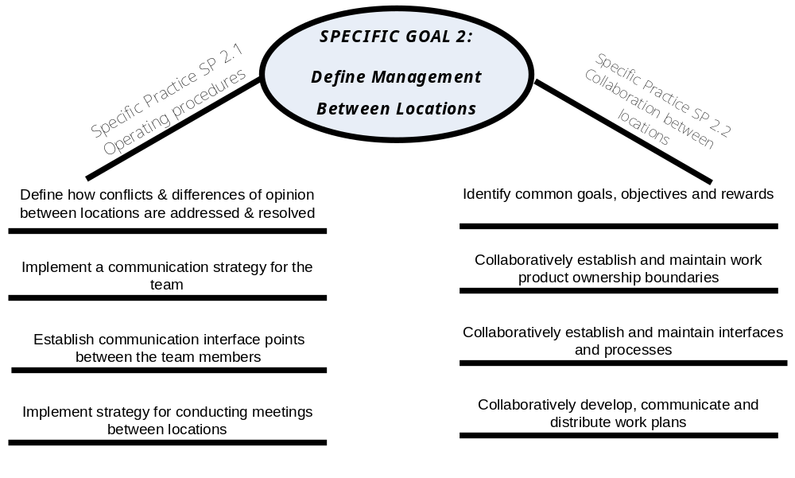
Global Teaming Model
Implement strategy for conducting meetings between locations

Slide 31
Specific Environment Example:
Global Software Development
How can you ensure that the processes you implement will work in a Global environment?
Local processes are not global processes!

Slide 32
RD and REQM
Processes developed for Software Development must be viewed in a real life situations
…….. Specific industries
  Regulated Environment
    Health, Financial Services, Automotive etc
…….. Specific environments
  Global Software Development, Services Development, Small to Medium Sized companies etc.

Slide 33
References
Paulk, Mark C., Bill Curtis, Mary Beth Chrissis and Charles V. Weber, 1993, "The Capability Maturity Model for Software, Version 1.1", Technical Report SEI-93-TR-24, Software Engineering Institute, Carnegie Mellon University, U.S.A.
Software Engineering Institute, CMMI Version 1.3, November 2010 http://www.sei.cmu.edu/library/abstracts/reports/10tr033.cfm
Richardson, Ita, Valentine Casey, John Burton, Fergal McCaffery, Global Software Engineering: A Software Process Approach, in Collaborative Software Engineering, edited by Mistrík, I.; Grundy, J.; Hoek, A. van der; Whitehead, J., 2010, ISBN: 978-3-642-10293-6, pp35-56.
Richardson, Ita, Ó hAodha, Mícheál (Eds.), Software Testing and Global Industry: Future Paradigms by Valentine Casey, Cambridge Scholars Publishing, 2008, ISBN: 97801-4438-0109-6.
Shroff, Vispi, Louise Reid and Ita Richardson, A Theoretical Framework for Software Quality in the Healthcare and Medical Industry, European Systems and Software Process Improvement and Innovation Conference, EuroSPI 2011, 27-29th June 2011, Roskilde University, Roskilde (Copenhagen), Denmark.
Mc Caffery, Fergal, John Burton and Ita Richardson, Risk Management Capability Model (RMCM) for the Development of Medical Device Software, Software Quality Journal, Volume 18, Issue 1 (2010), Page 81, DOI: 10.1007/s11219-009-9086-7.
  Šmite, Darja, PhD Thesis, Riga Information Technology Institute, University of Latvia, 2007

Slide 34
Ita.richardson@lero.ie

